Slide 1
Software Project Management
Chapter 6. Selecting a Project Team

Slide 2
Individual Personality Type
Starting with the individual, several personality models have been derived from Carl Jung's theory of "psychological types. That are:
The Myers-Briggs Type Indicator (MBTI)
The Fundamental Interpersonal Relations Orientation Behavior (FIRO-B) model
The Keirsey Temperament Sorter, the Kahler Process Communication Model (PCM)

Slide 3
FIRO-B Instrument
Another tool that requires certification to administer is the Fundamental Interpersonal Relations Orientation-Measuring Behavior (FIRO-B).
It is an efficient measure of interpersonal relationships, and it has been normalized by data from tens of thousands of individuals across 15 occupations.
All humans possess three basic needs, to a greater or lesser degree. They are the needs for inclusion, control, and affection.

Slide 4
Continue…
Inclusion is the inner drive "to establish and maintain a satisfactory relation with people with respect to interaction and association." It has to do with being "in" or "out.
Control is "the need to establish and maintain a satisfactory relation with people with respect to control and power." It has to do with being on top or on the bottom.
The third need of the triad is "the need to establish and maintain a satisfactory relationship with others with respect to love and affection." It has to do with being close or far.

Slide 5
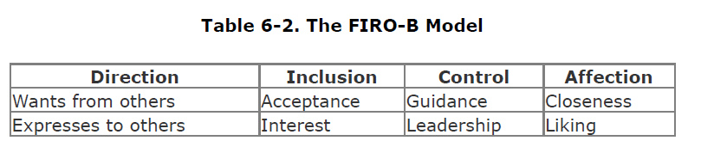
Continue…
Applying the FIRO-B postulate of compatibility to teams helps determine which individuals will work well together and which ones will clash.

Slide 6
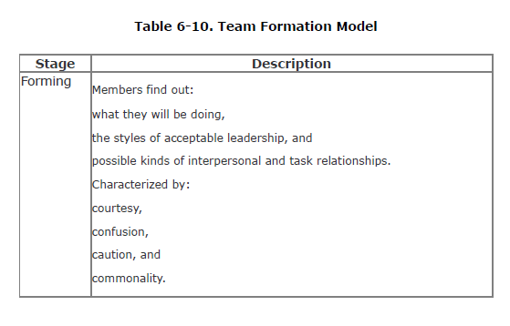
Understand Group Dynamics
A leader must recognize how teams form to be able to lead them properly. A well-known model of team formation is the five-stage model.

Slide 7
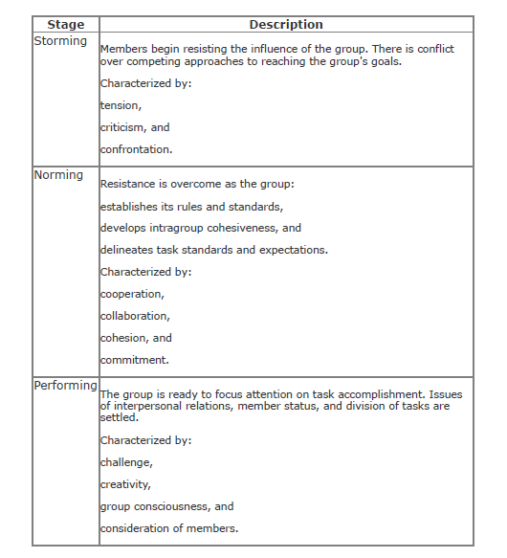

Slide 8
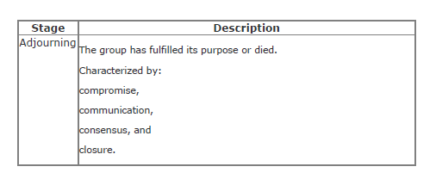
Continue…
This model depicts the process of how a group decides on its operating profile. The profile is different for every group and is time- and place-dependent.

Slide 9
Recognize Teamicide
Teamicide is the result of group dynamics in the organizational environment that become stuck in the storming stage, causing the members to retreat into the roots of their personalities, often critically.
A technical project leader should look for signs that any of these are occurring and take action to correct them immediately. DeMarco and Lister give us some hints:
Defensive management Allow the staff to make their own decisions, even if they sometimes make a mistake. Giving them the freedom to make errors is a sign of trust.

Slide 10
